Slide 1
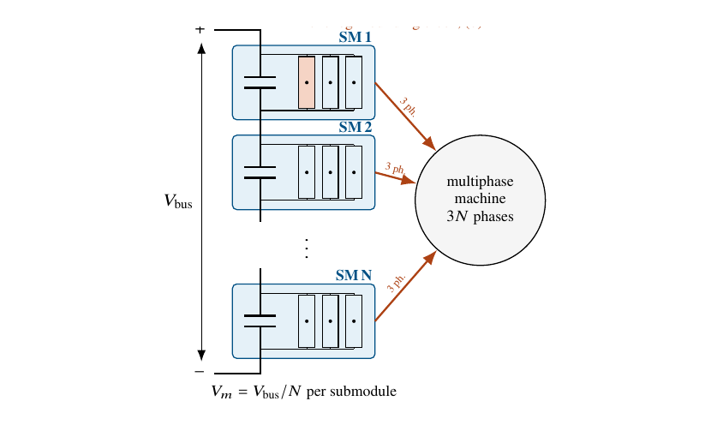
Enes Ayaz
PhD topic: High-voltage traction drives
THE PROJECT
Background Higher DC-link voltages enable high-power traction drives for electric trucks.
Challenge Voltage, device selection and motor design must be evaluated together to balance efficiency, power density and motor stress.
Goal Moore4Power: improve efficiency using low-voltage devices and integrated motor–inverter design.
CURRENT PROJECT
Moore4Power
Newly started • Power electronics for vehicles
Focus: low-voltage devices in a high-voltage drive
DONE SO FAR
PowerizeD (completed): two-level prototype with new e-truck power modules.
HemiZero (finishing): two-level design and motor–inverter tradeoffs; 1.2 kV prototype efficiency ≈99.1%.*
ONGOING → NEXT
Now: Moore4Power: low-voltage GaN building blocks for a stacked polyphase bridge (SPB).
Next: integrated motor–inverter design and experimental validation of efficiency gains.
SPB concept: low-voltage bridges feed a multiphase motor.
SELECTED PUBLICATIONS / RESULTS
Ayaz et al., “Evaluation of Possible Traction Inverter Topologies for Heavy-Duty Electric Vehicles,” SPEC 2024.
*1.2 kV study: ≈99.12% prototype efficiency; inverter loss prediction within ≈10%.
METHODS & TOOLS
Loss modelling
MATLAB/Simulink
Prototype testing
Notes:
Sources: user project status and scope, October 2026. PowerizeD completed; HemiZero nearing completion; Moore4Power newly started. Prototype efficiency and loss-model accuracy: 1.2kV-Paper/Submission/Accepted Files/manuscript.pdf, abstract; 250 kW, 1.2 kV SiC prototype. This is earlier PowerizeD/HemiZero work, not measured Moore4Power results. Figure: PCB-Design/reports/paper/figures/fig_spb_standalone.pdf, panel (a), cropped from existing research figure. SPB work is design/simulation and planned experimental validation. Publication: SPECS-2024/manuscript/manuscript.pdf. No project-wide Moore4Power efficiency improvement has yet been demonstrated in the sources reviewed.

